Slide 1


Azərbaycan Dövlət Neft və Sənaye Universiteti
Calculus
Single Variable

Slide 2
Differentiation

Slide 3
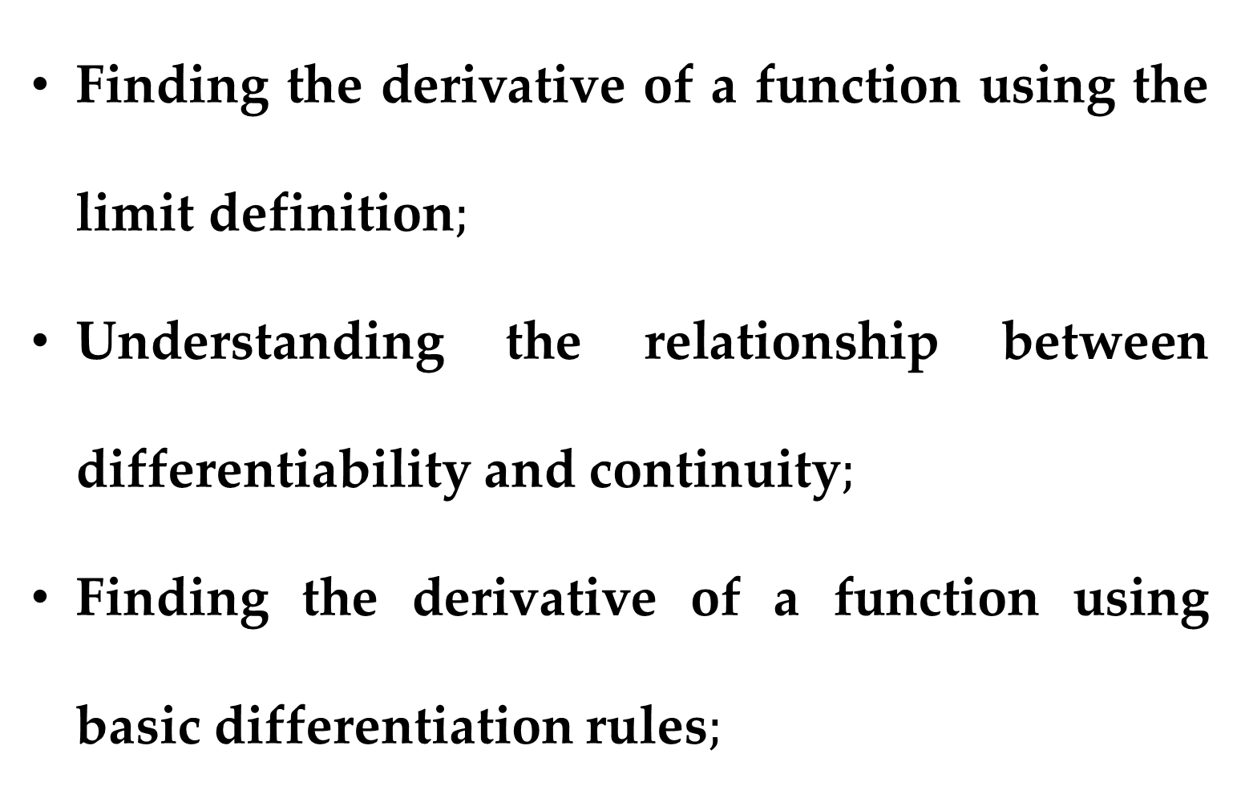
$$Outline$$
Finding the derivative of a function using the limit definition$;$
Understanding the relationship between differentiability and continuity$;$
Finding the derivative of a function using basic differentiation rules$;$

Slide 4
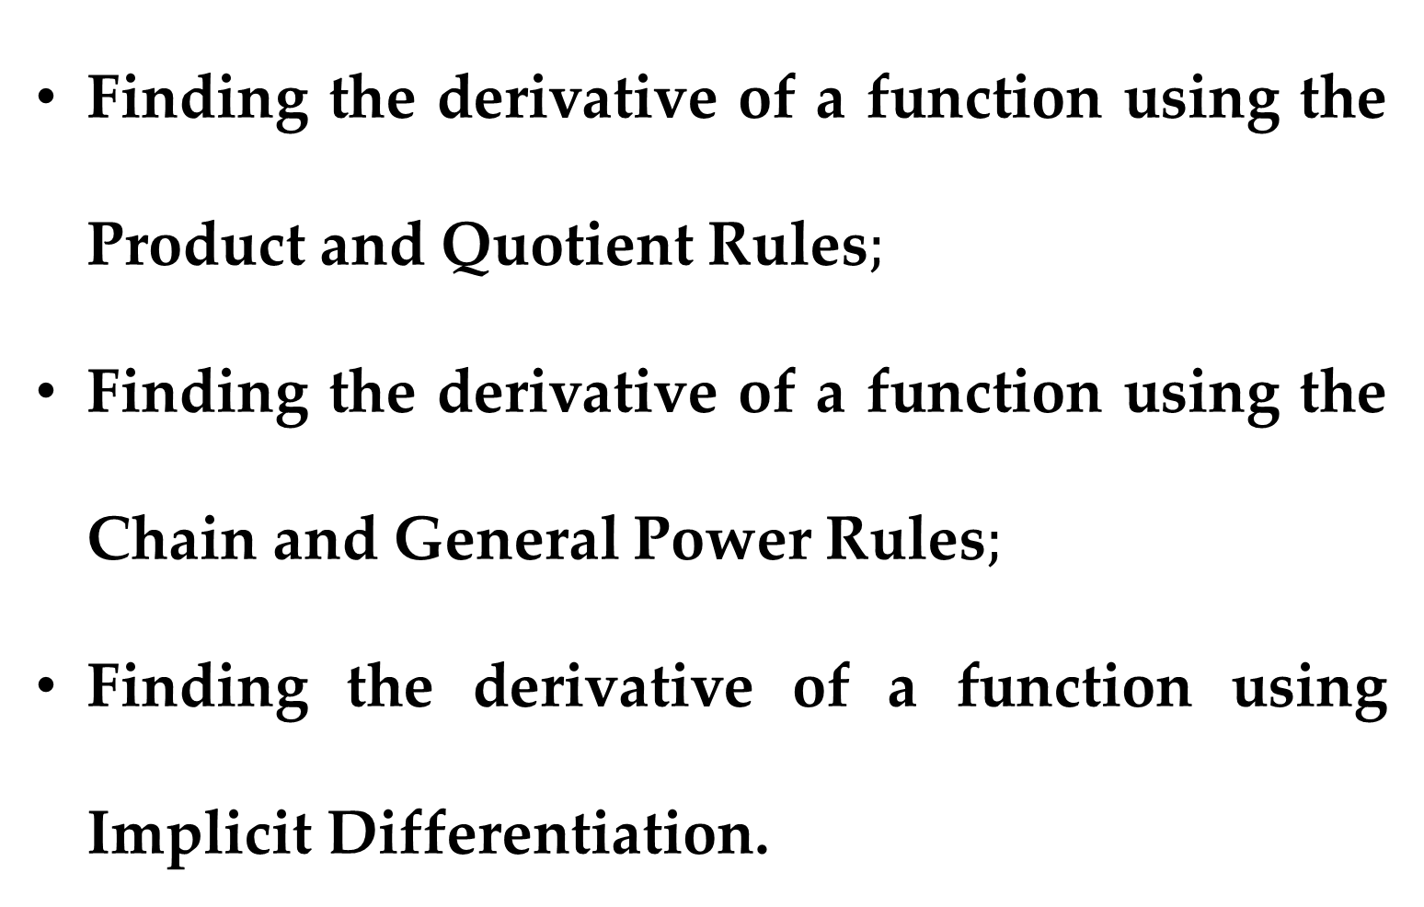
$$Outline$$
Finding the derivative of a function using the Product and Quotient Rules$;$
Finding the derivative of a function using the Chain and General Power Rules$;$
Finding the derivative of a function using Implicit Differentiation.

Slide 5
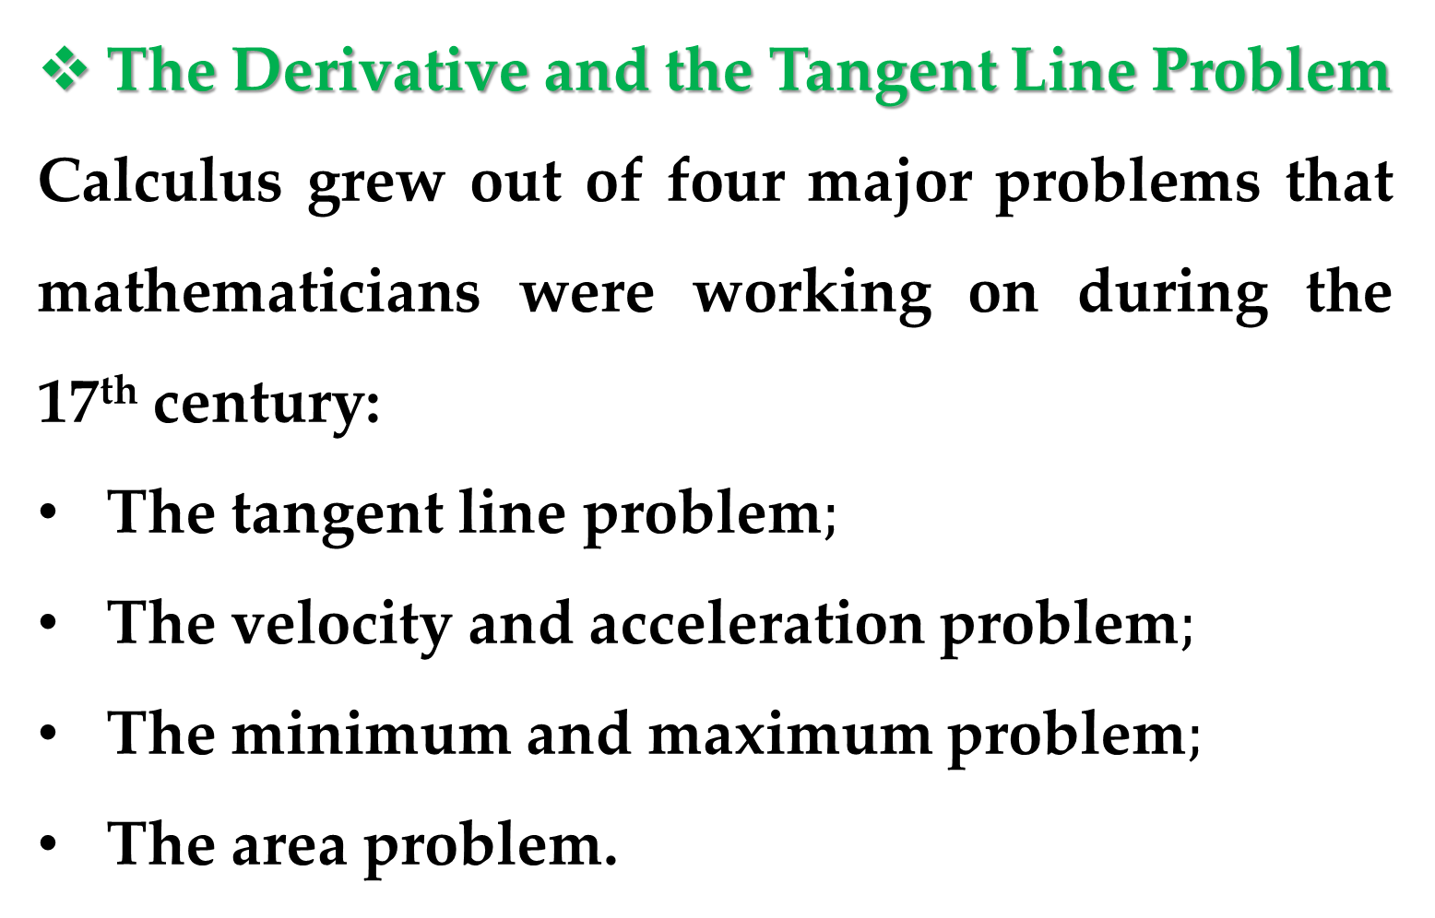
The Derivative and the Tangent Line Problem
Calculus grew out of four major problems that mathematicians were working on during the 17th century:
The tangent line problem$;$
The velocity and acceleration problem$;$
The minimum and maximum problem$;$
The area problem.

Slide 6
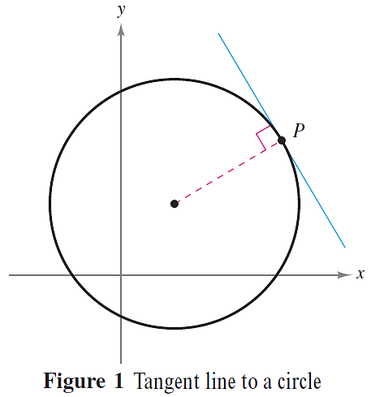
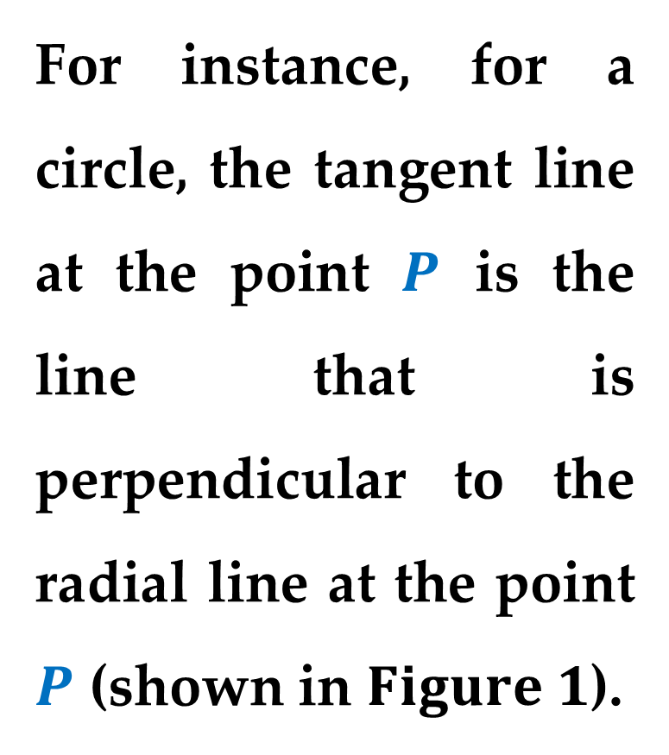
What does it mean to say that a line is tangent to a curve at a point?
For instance, for a circle, the tangent line at the point $P$ is the line that is perpendicular to the radial line at the point $P$ (shown in $Figure 1$).

Slide 7
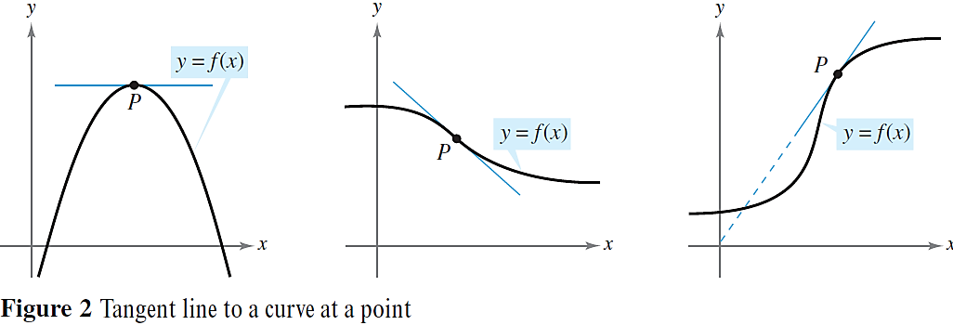
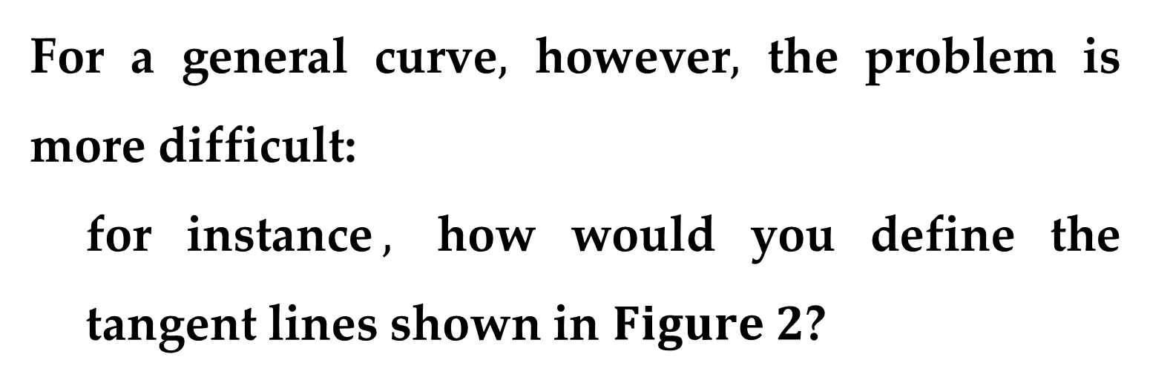
For a general curve$,$ however$,$ the problem is more difficult:
for instance$,$ how would you define the tangent lines shown in $Figure 2$?

Slide 8
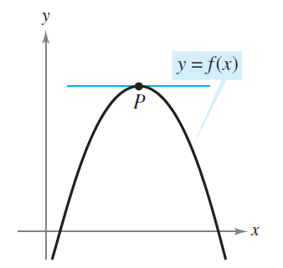
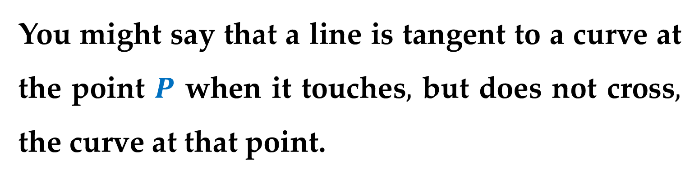
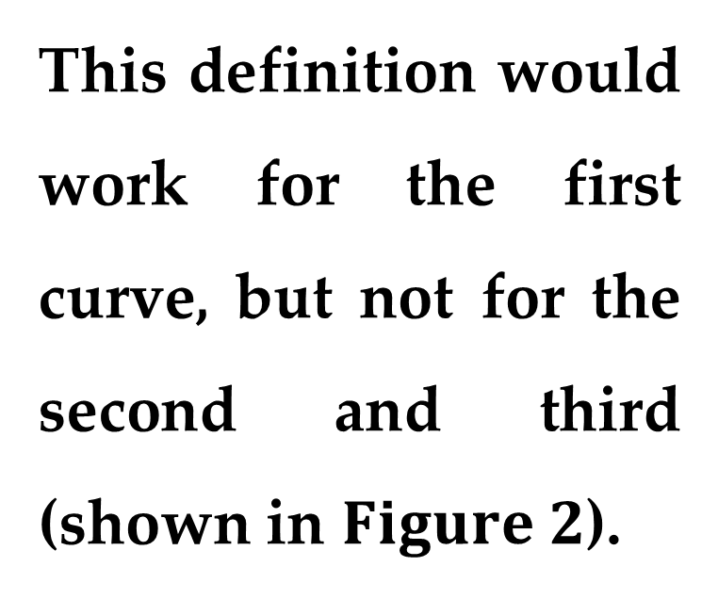
You might say that a line is tangent to a curve at the point $P$ when it touches$,$ but does not cross$,$ the curve at that point.
This definition would work for the first curve, but not for the second and third (shown in $Figure 2$).

Slide 9
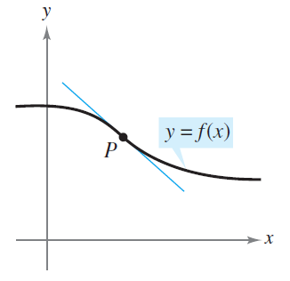
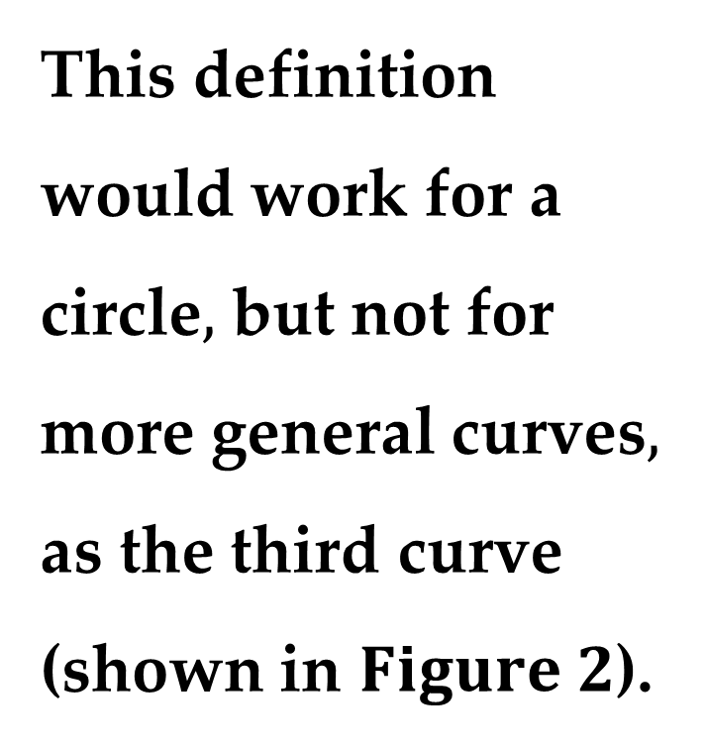
You might say that a line is tangent to a curve when the line touches or intersects the curve at exactly one point.
This definition would work for a circle$,$ but not for more general curves$,$ as the third curve (shown in $Figure 2$).

Slide 10
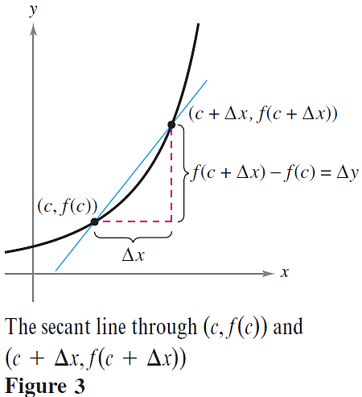
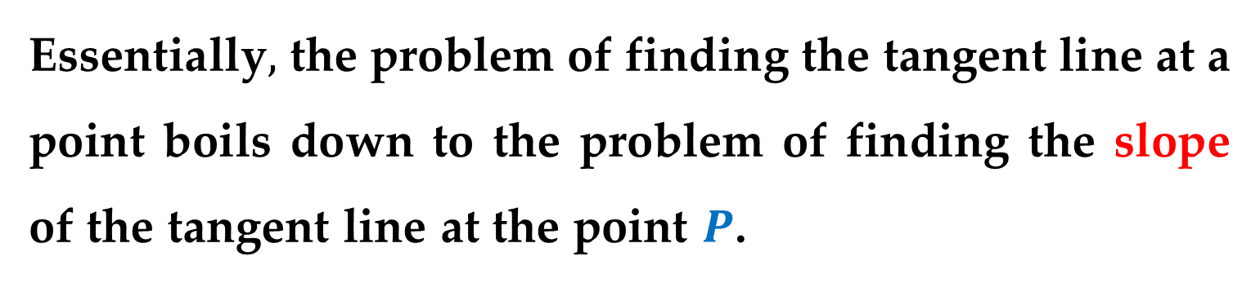
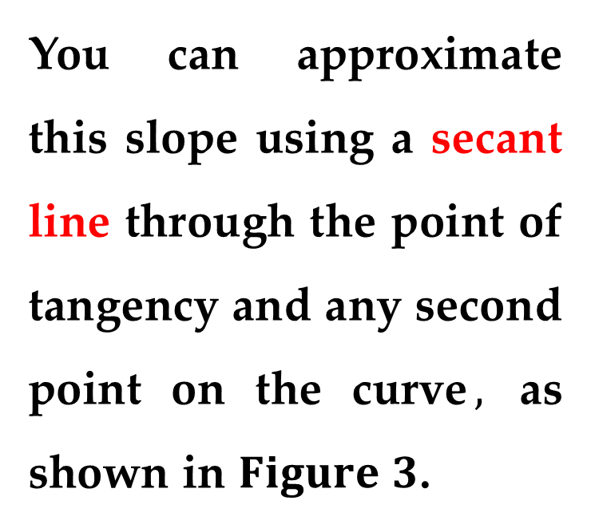
Essentially$,$ the problem of finding the tangent line at a point boils down to the problem of finding the slope of the tangent line at the point $P$.
You can approximate this slope using a secant line through the point of tangency and any second point on the curve$,$ as shown in $Figure 3$.

Slide 11
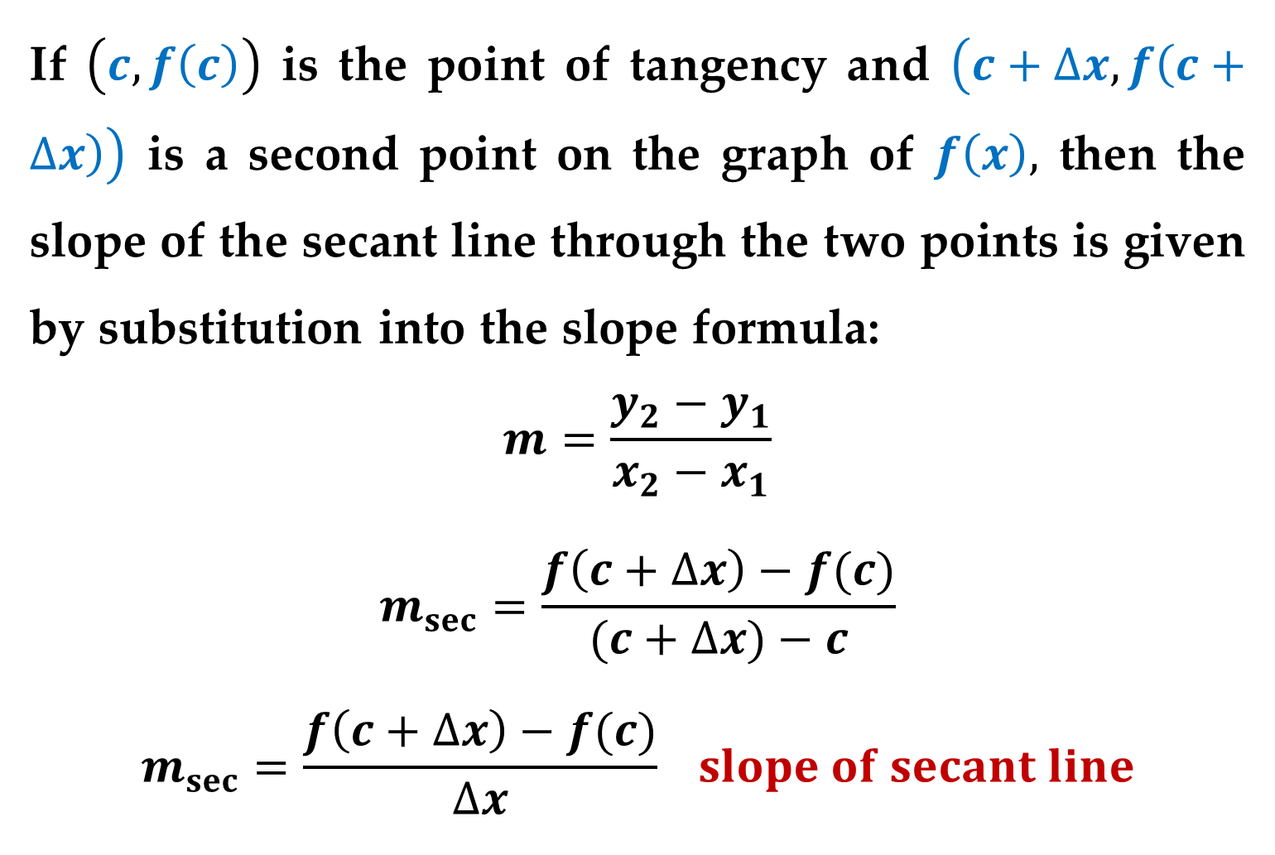
If $\left(c,f\left(c\right)\right)$ is the point of tangency and $\left(c+∆x,f\left(c+∆x\right)\right)$ is a second point on the graph of $f\left(x\right),$ then the slope of the secant line through the two points is given by substitution into the slope formula:
$$m=\frac{y_{2}−y_{1}}{x_{2}−x_{1}}$$
$$m_{sec}=\frac{f\left(c+∆x\right)−f(c)}{(c+∆x)−c}$$
$$m_{sec}=\frac{f\left(c+∆x\right)−f(c)}{∆x} slope of secant line$$

Slide 12
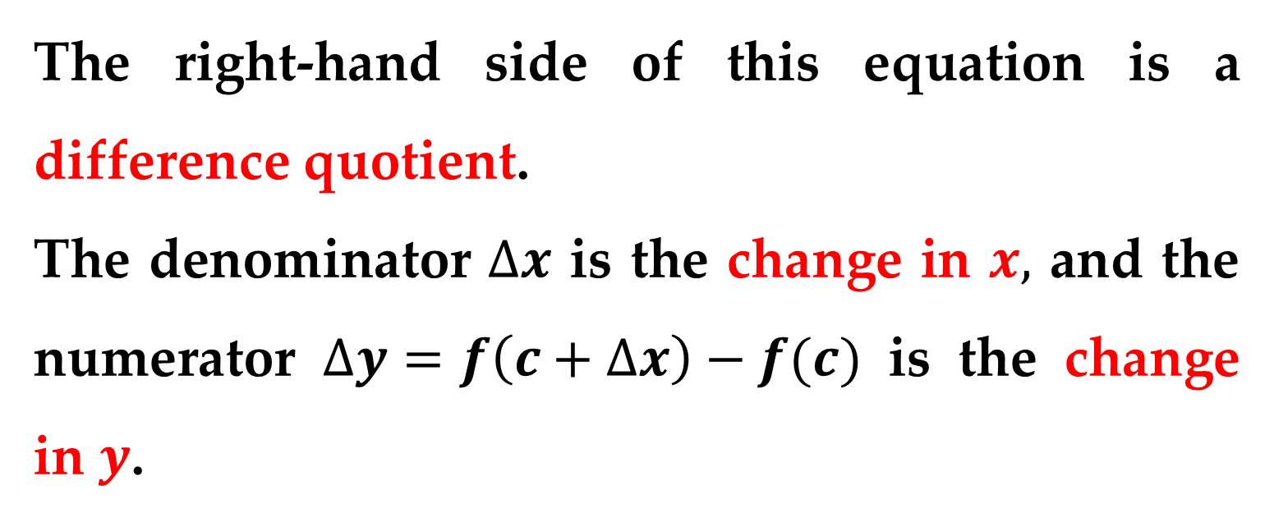
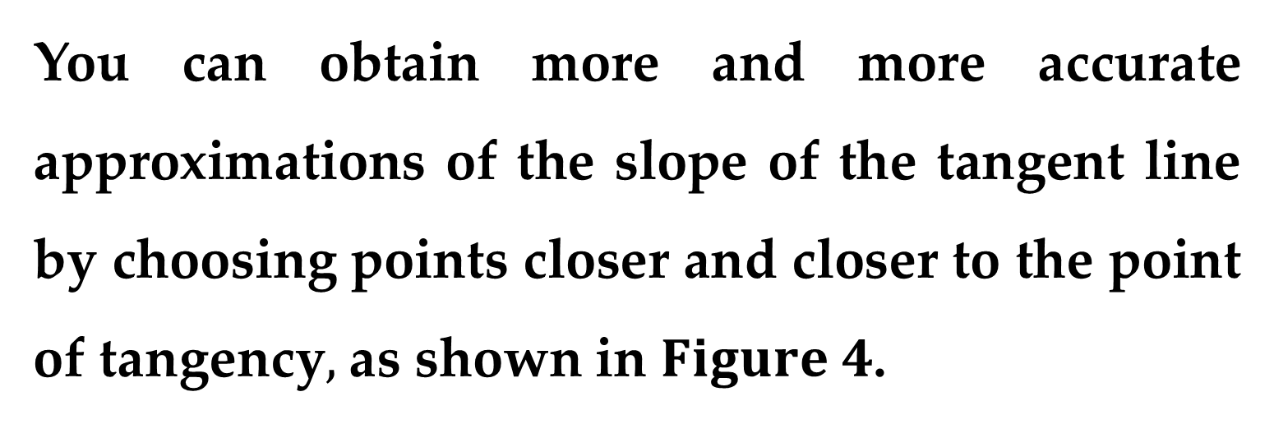
The right-hand side of this equation is a difference quotient.
The denominator $∆x$ is the change in $x,$ and the numerator $∆y=f\left(c+∆x\right)−f(c)$ is the change in $y$.
You can obtain more and more accurate approximations of the slope of the tangent line by choosing points closer and closer to the point of tangency$,$ as shown in $Figure 4$.

Slide 13
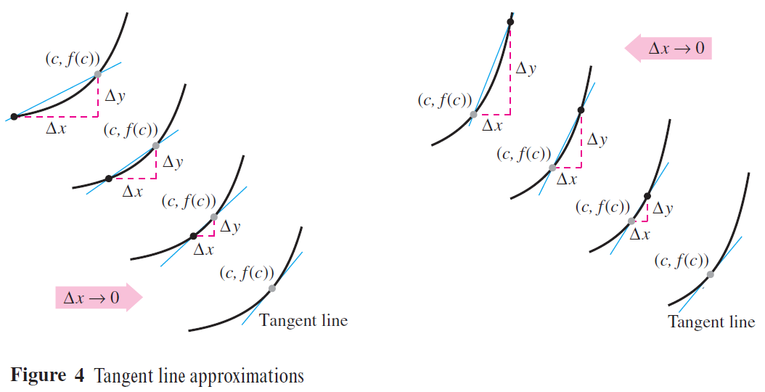

Slide 14
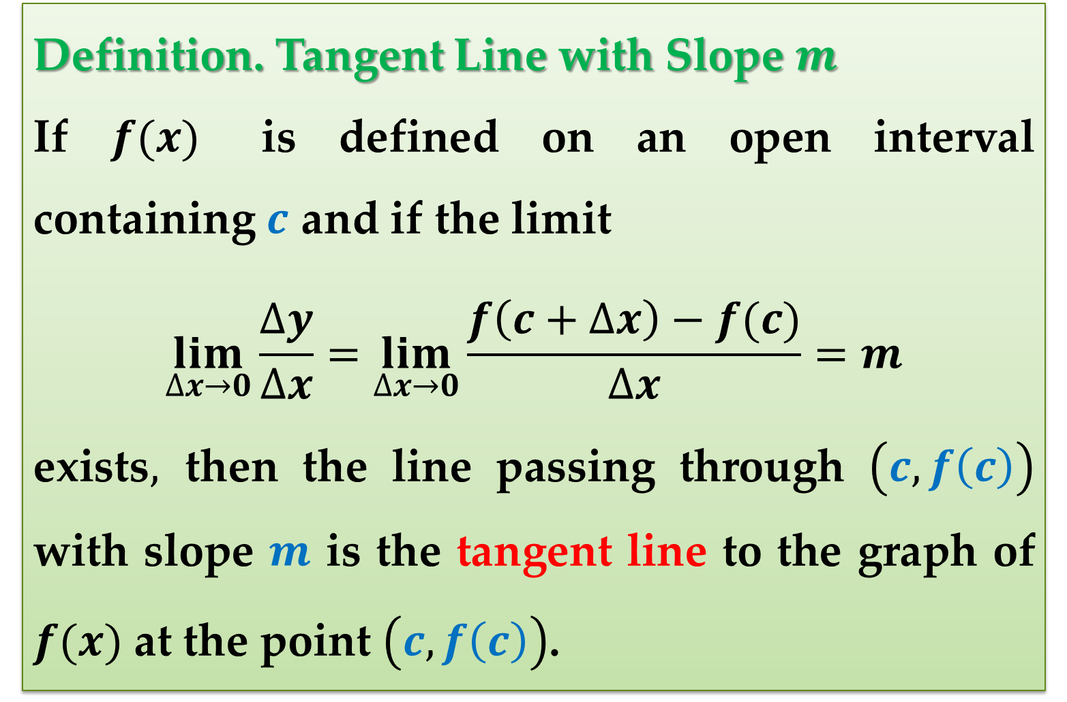
Definition. Tangent Line with Slope $m$
If $f(x)$ is defined on an open interval containing $c$ and if the limit
$$\lim_{∆x→0}{\frac{∆y}{∆x}}=\lim_{∆x→0}{\frac{f\left(c+∆x\right)−f(c)}{∆x}}=m$$
exists$,$ then the line passing through $\left(c,f\left(c\right)\right)$ with slope $m$ is the tangent line to the graph of $f(x)$ at the point $\left(c,f\left(c\right)\right)$.

Slide 15
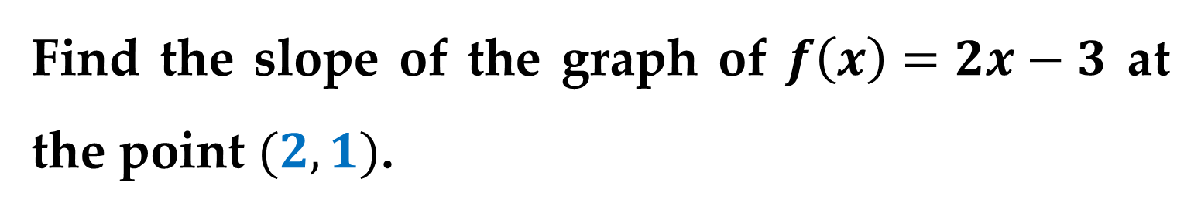
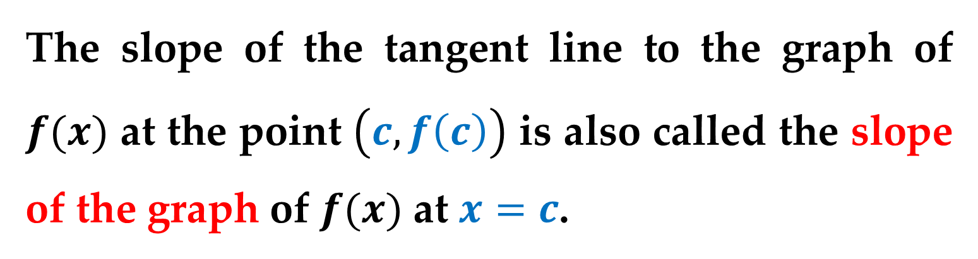
The slope of the tangent line to the graph of $f(x)$ at the point $\left(c,f\left(c\right)\right)$ is also called the slope of the graph of $f(x)$ at $x=c$.
Example 1. The Slope of the Graph of a Linear Function
Find the slope of the graph of $f\left(x\right)=2x−3$ at the point $(2,1)$.

Slide 16
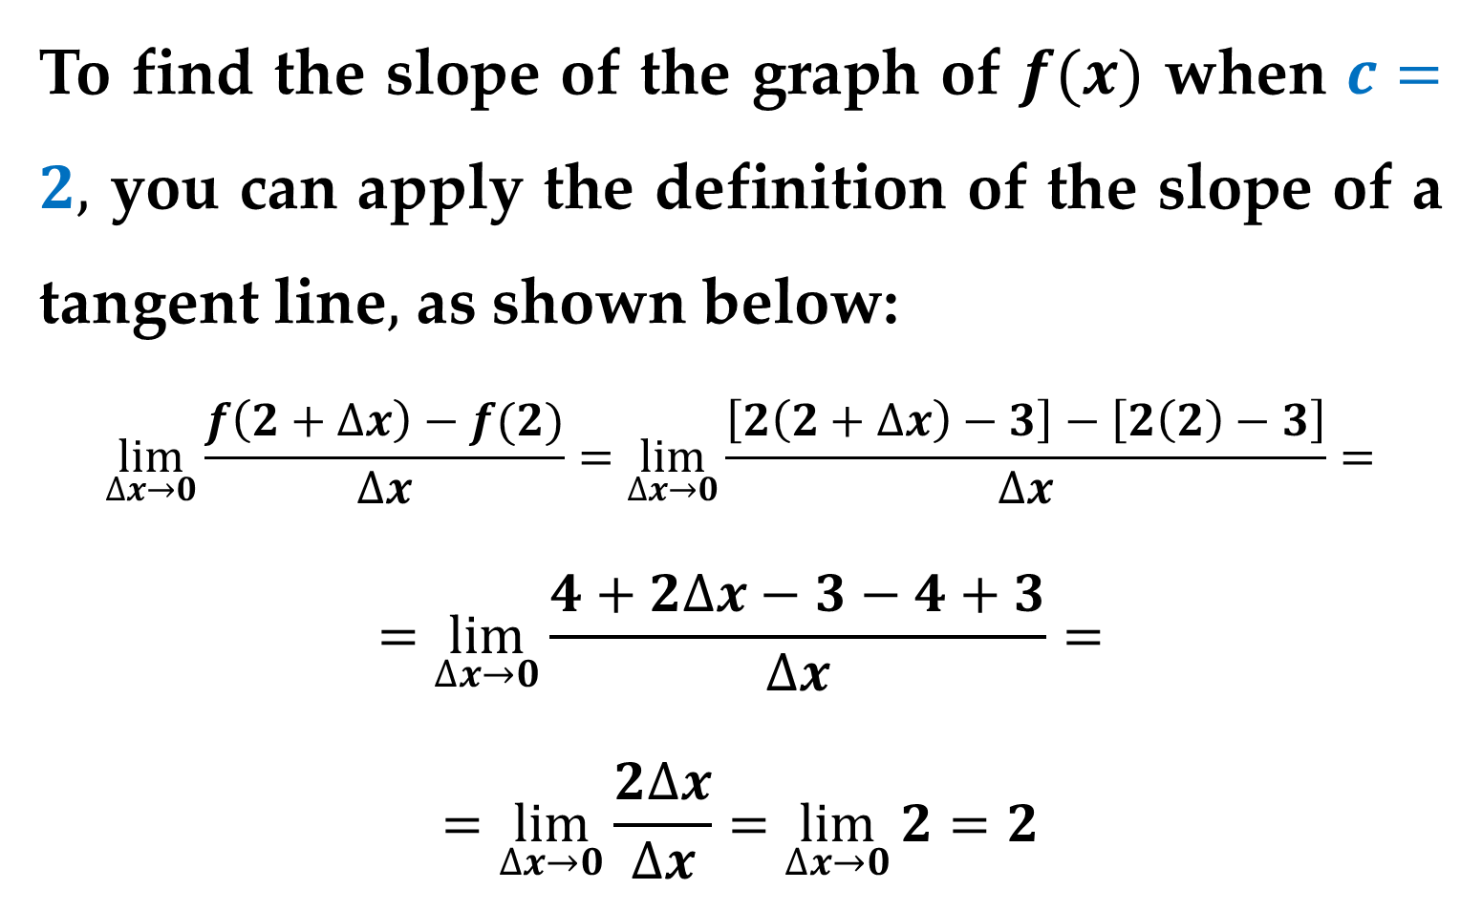
Solution
To find the slope of the graph of $f(x)$ when $c=2,$ you can apply the definition of the slope of a tangent line$,$ as shown below:
$$\lim_{∆x→0}{\frac{f\left(2+∆x\right)−f(2)}{∆x}}=\lim_{∆x→0}{\frac{\left[2\left(2+∆x\right)−3\right]−\left[2\left(2\right)−3\right]}{∆x}}=$$
$$=\lim_{∆x→0}{\frac{4+2∆x−3−4+3}{∆x}}=$$
$$=\lim_{∆x→0}{\frac{2∆x}{∆x}}=\lim_{∆x→0}{2}=2$$

Slide 17
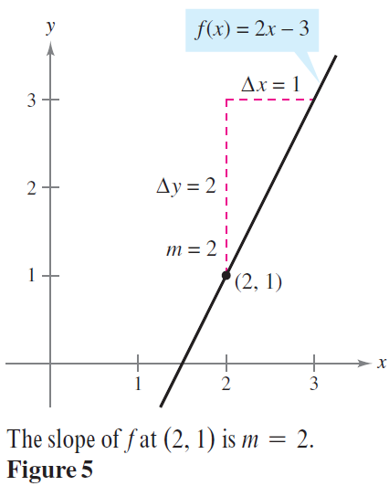
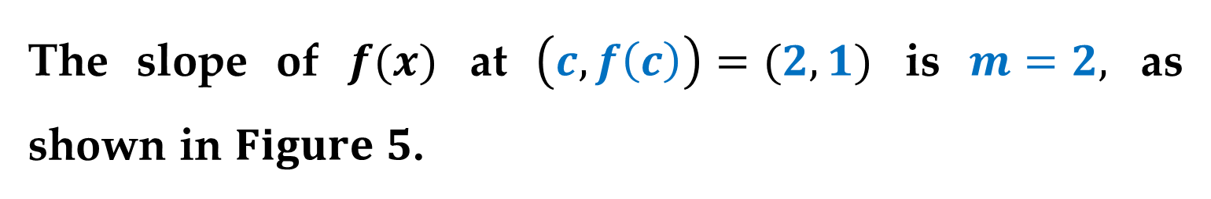
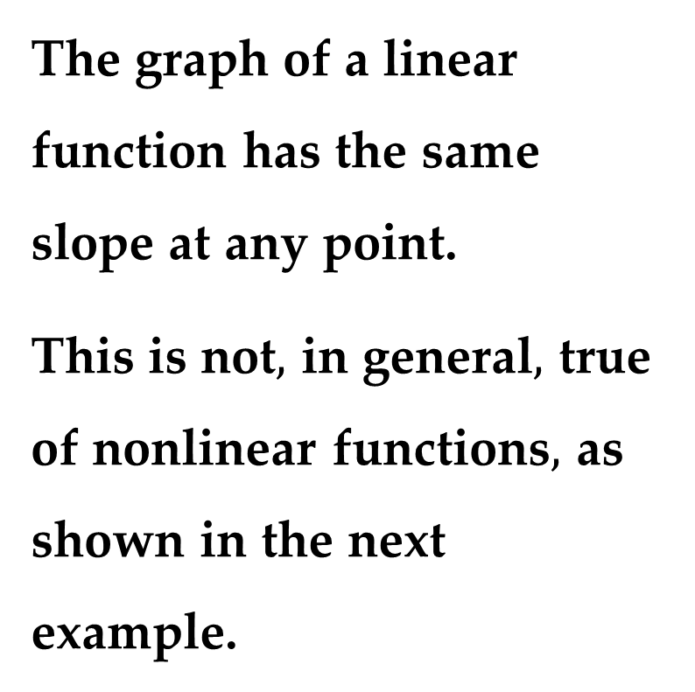
Solution (continued)
The slope of $f(x)$ at $\left(c,f\left(c\right)\right)=(2,1)$ is $m=2,$ as shown in $Figure 5$.
The graph of a linear function has the same slope at any point.
This is not$,$ in general$,$ true of nonlinear functions$,$ as shown in the next example.

Slide 18
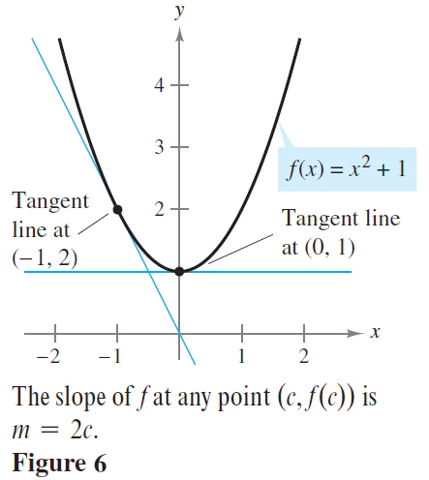
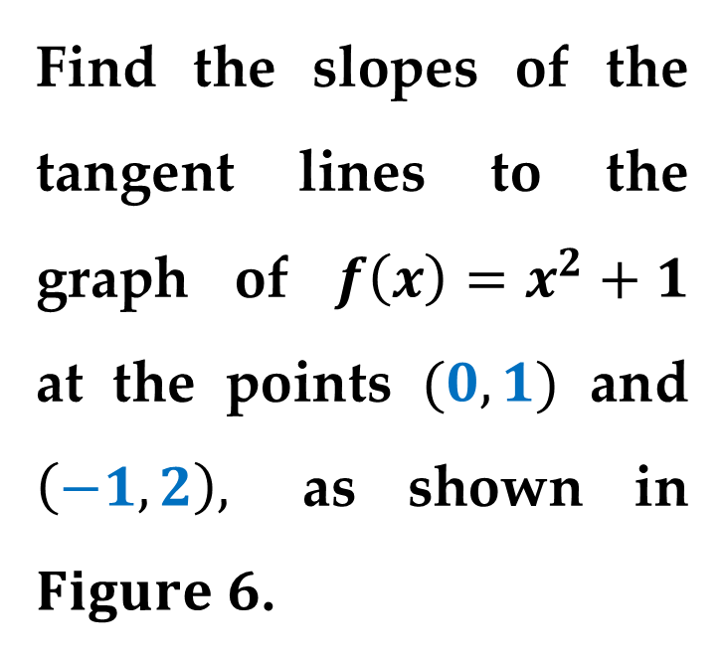
Example 2. Tangent Lines to the Graph of a Nonlinear Function
Find the slopes of the tangent lines to the graph of $f\left(x\right)=x^{2}+1$ at the points $(0,1)$ and $\left(−1,2\right),$ as shown in $Figure 6$.

Slide 19
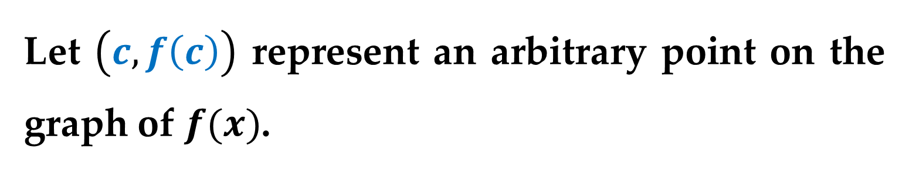
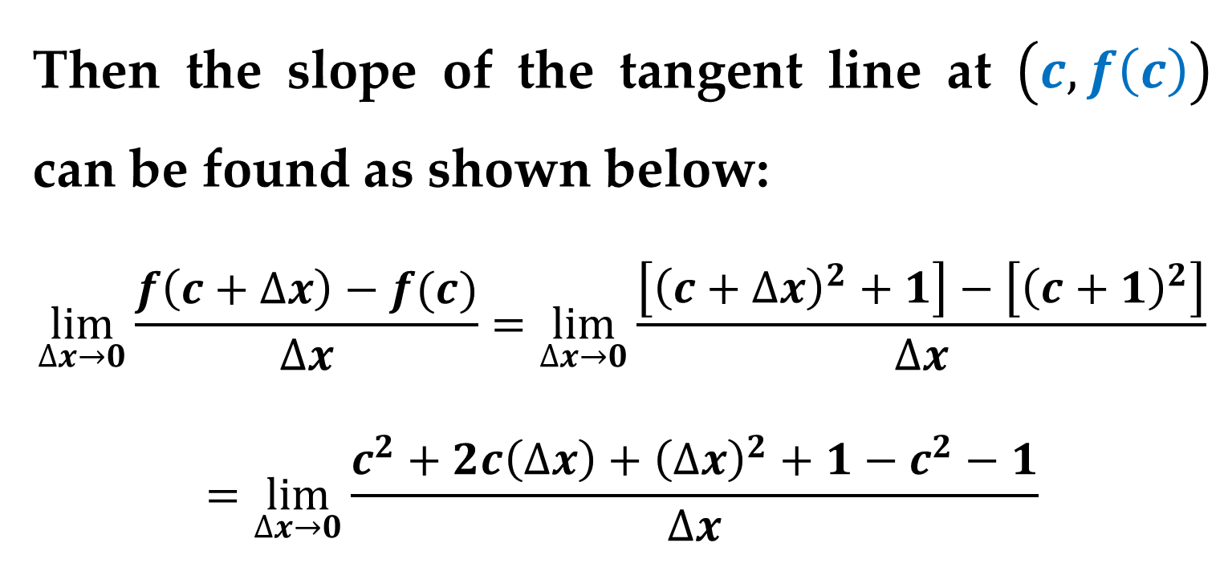
Solution
Let $\left(c,f\left(c\right)\right)$ represent an arbitrary point on the graph of $f(x)$.
Then the slope of the tangent line at $\left(c,f\left(c\right)\right)$ can be found as shown below:
$$\lim_{∆x→0}{\frac{f\left(c+∆x\right)−f(c)}{∆x}}=\lim_{∆x→0}{\frac{\left[{\left(c+∆x\right)}^{2}+1\right]−\left[{\left(c+1\right)}^{2}\right]}{∆x}}$$
$$=\lim_{∆x→0}\frac{c^{2}+2c\left(∆x\right)+{\left(∆x\right)}^{2}+1−c^{2}−1}{∆x}$$

Slide 20
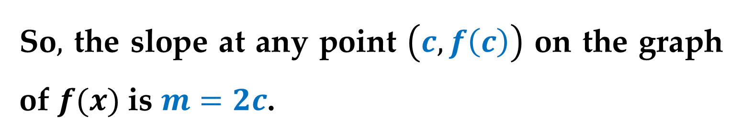
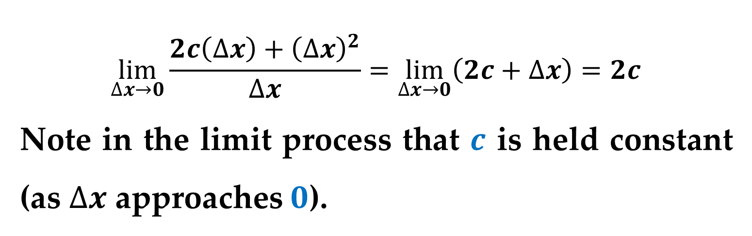
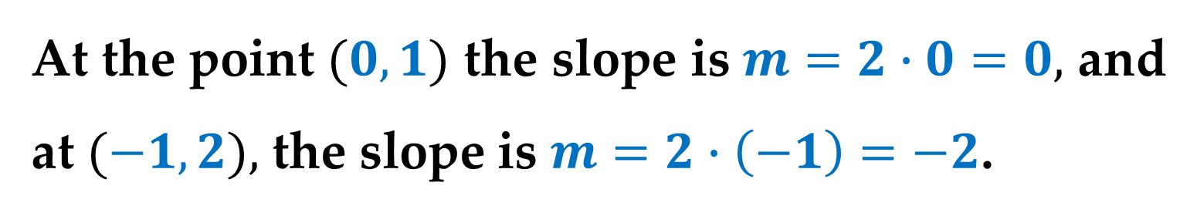
Solution (continued)
$$\lim_{∆x→0}{\frac{2c\left(∆x\right)+{\left(∆x\right)}^{2}}{∆x}}=\lim_{∆x→0}\left(2c+∆x\right)=2c$$
Note in the limit process that $c$ is held constant (as $∆x$ approaches $0$).
So$,$ the slope at any point $\left(c,f\left(c\right)\right)$ on the graph of $f(x)$ is $m=2c$.
At the point $(0,1)$ the slope is $m=2∙0=0,$ and at $(−1,2),$ the slope is $m=2∙\left(−1\right)=−2$.

Slide 21
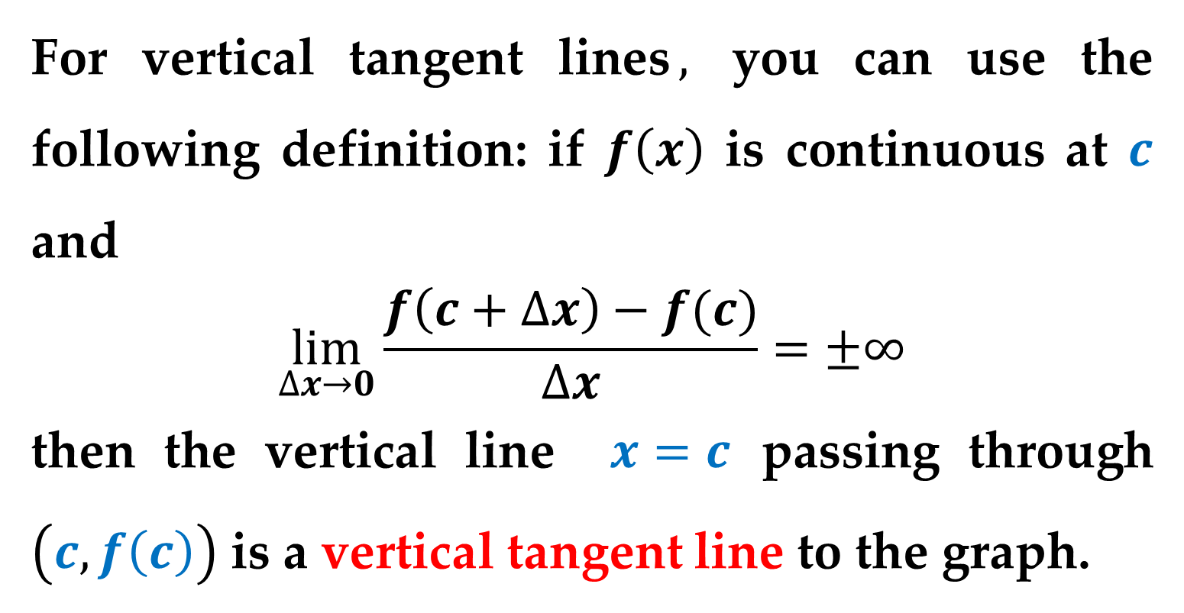
The definition of a tangent line to a curve does not cover the possibility of a vertical tangent line.
For vertical tangent lines$,$ you can use the following definition: if $f\left(x\right)$ is continuous at $c$ and
$$\lim_{∆x→0}{\frac{f\left(c+∆x\right)−f(c)}{∆x}}=±∞$$
then the vertical line $x=c$ passing through $\left(c,f\left(c\right)\right)$ is a vertical tangent line to the graph.

Slide 22
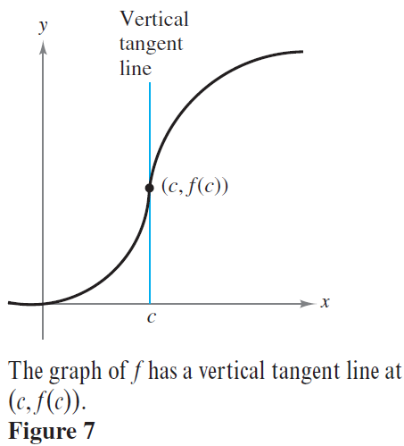
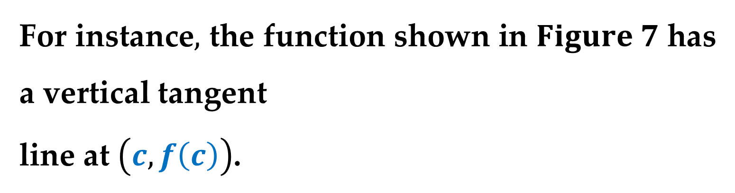
For instance$,$ the function shown in $Figure 7$ has a vertical tangent
line at $\left(c,f\left(c\right)\right)$.

Slide 23
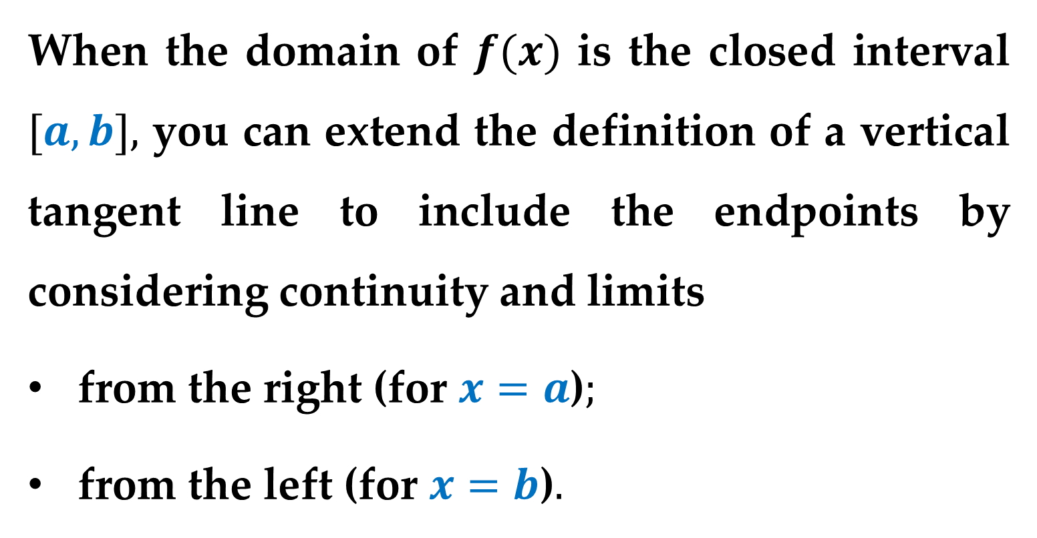
When the domain of $f(x)$ is the closed interval $[a,b],$ you can extend the definition of a vertical tangent line to include the endpoints by considering continuity and limits
from the right (for $x=a$)$;$
from the left (for $x=b$)$.$

Slide 24
The Derivative of a Function
The limit used to define the slope of a tangent line is also used to define one of the two fundamental operations of calculus — differentiation.

Slide 25
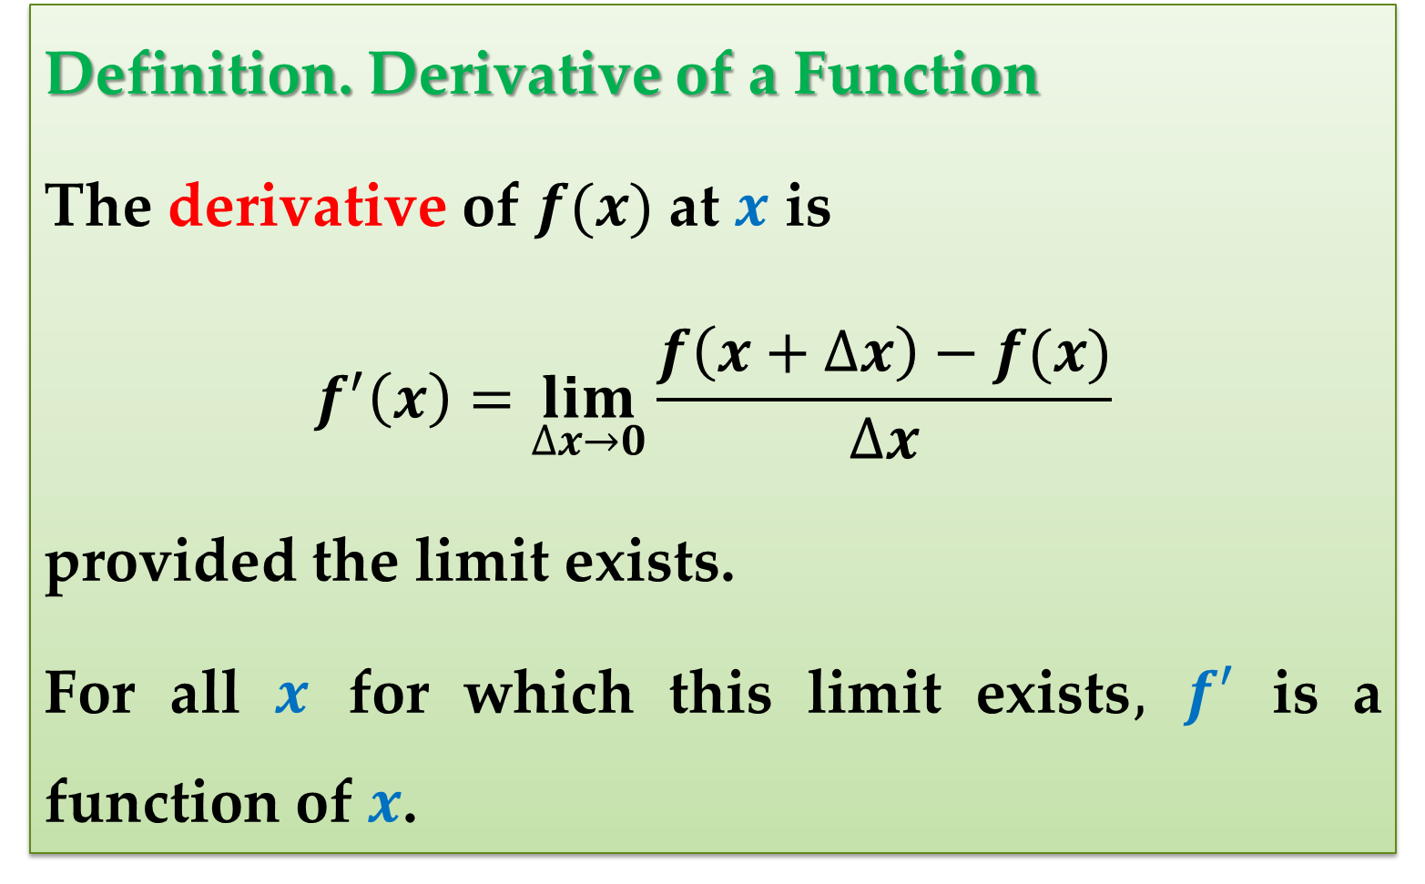
Definition. Derivative of a Function
The derivative of $f(x)$ at $x$ is
$$f^{′}\left(x\right)=\lim_{∆x→0}{\frac{f\left(x+∆x\right)−f(x)}{∆x}}$$
provided the limit exists.
For all $x$ for which this limit exists$,$ $f′$ is a function of $x$.

Slide 26
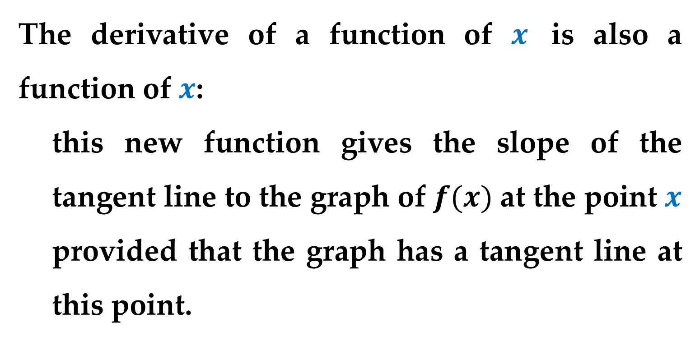
The derivative of a function of $x$ is also a function of $x$:
this new function gives the slope of the tangent line to the graph of $f(x)$ at the point $x$ provided that the graph has a tangent line at this point.
The process of finding the derivative of a function is called differentiation.

Slide 27
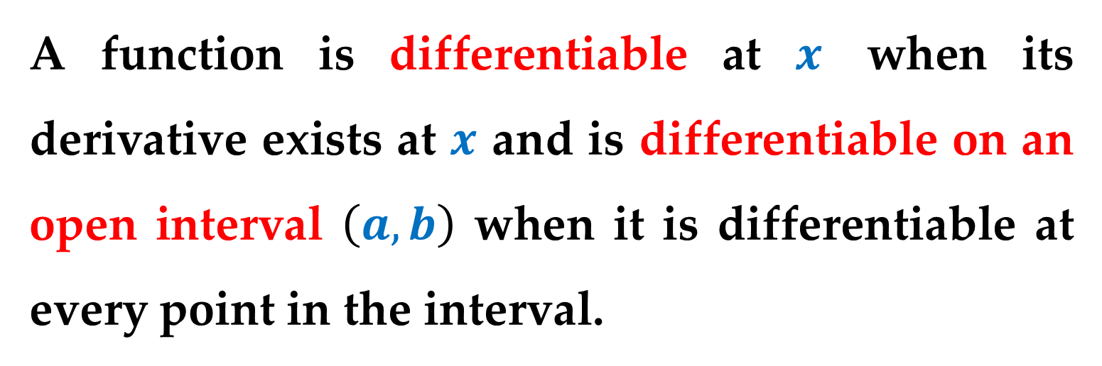
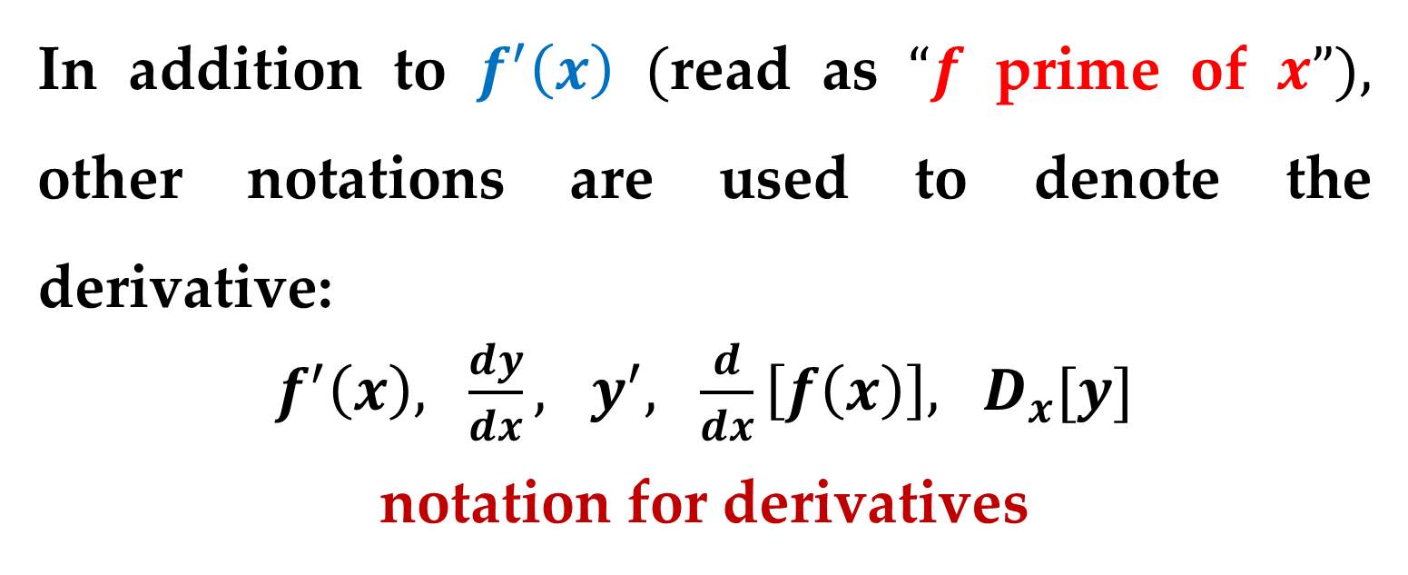
A function is differentiable at $x$ when its derivative exists at $x$ and is differentiable on an open interval $\left(a,b\right)$ when it is differentiable at every point in the interval.
In addition to $f^{′}\left(x\right)$ $($read as $“f$ prime of $x”),$ other notations are used to denote the derivative:
$f^{′}\left(x\right), \frac{dy}{dx}, y^{′}, \frac{d}{dx}\left[f\left(x\right)\right], D_{x}[y]$
notation for derivatives

Slide 28
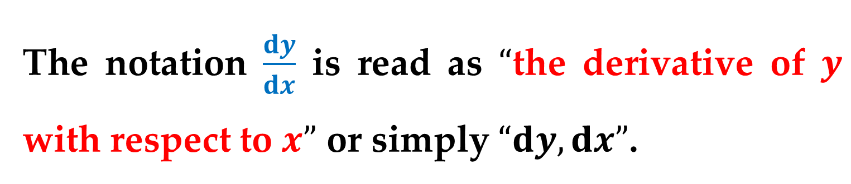
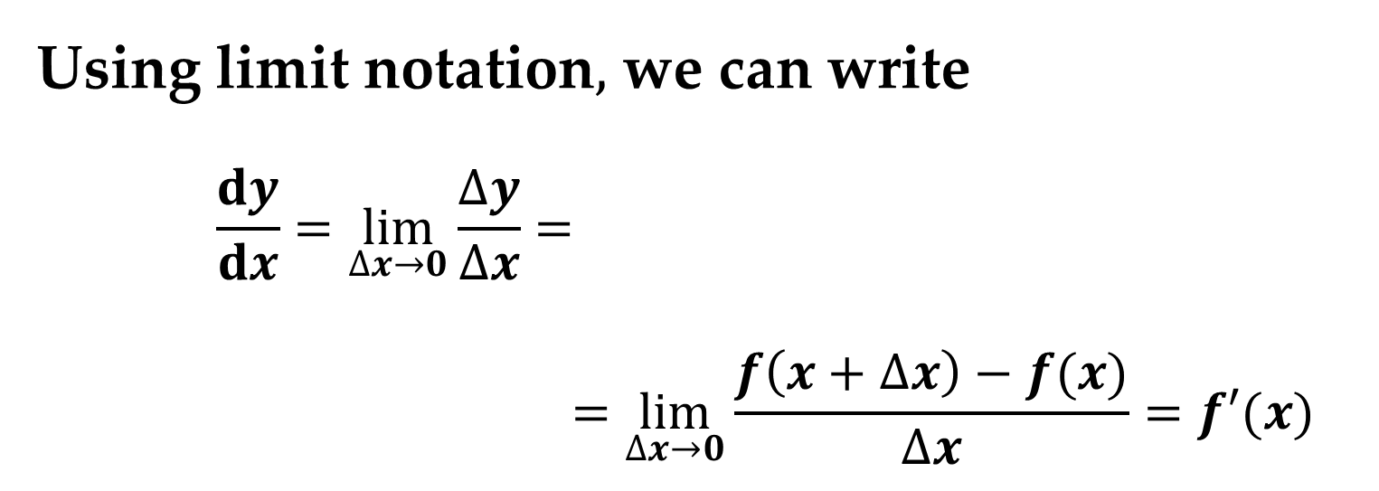
The notation $\frac{dy}{dx}$ is read as $“$the derivative of $y$ with respect to $x”$ or simply $“dy,dx”$.
Using limit notation$,$ we can write
$$\frac{dy}{dx}=\lim_{∆x→0}{\frac{∆y}{∆x}}=$$
$$=\lim_{∆x→0}{\frac{f\left(x+∆x\right)−f(x)}{∆x}}=f′(x)$$

Slide 29
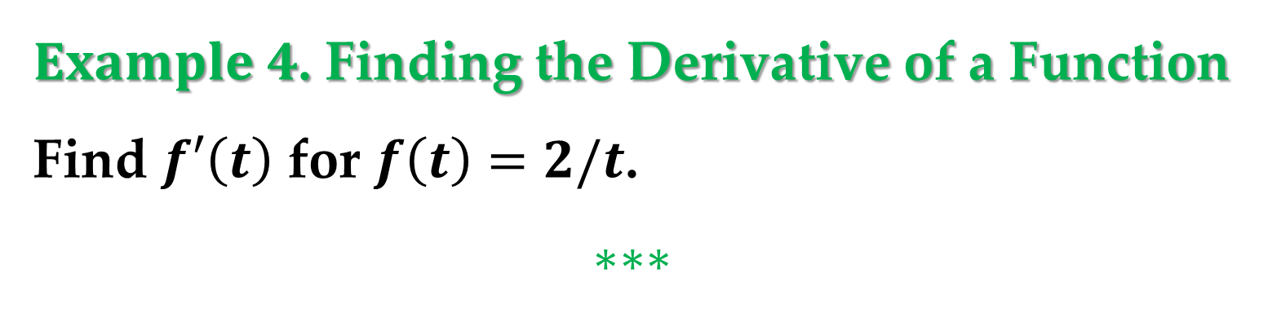

Example 3. Finding the Derivative by the Limit Process
Find the derivative of $f\left(x\right)=x^{3}+2x$.
$$∗∗∗$$
$Example 4$. Finding the Derivative of a Function
Find $f′\left(t\right)$ for $f\left(t\right)=2/t$.
$$∗∗∗$$

Slide 30
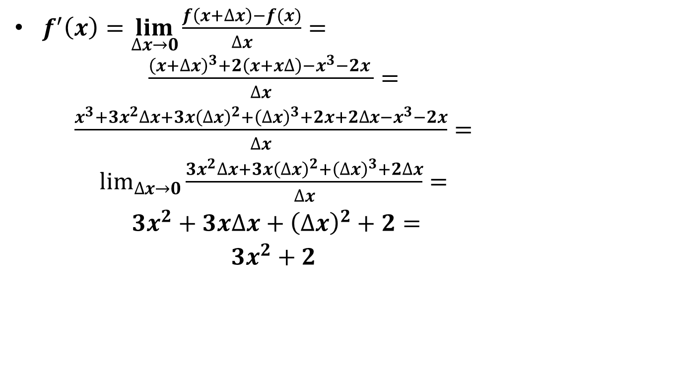
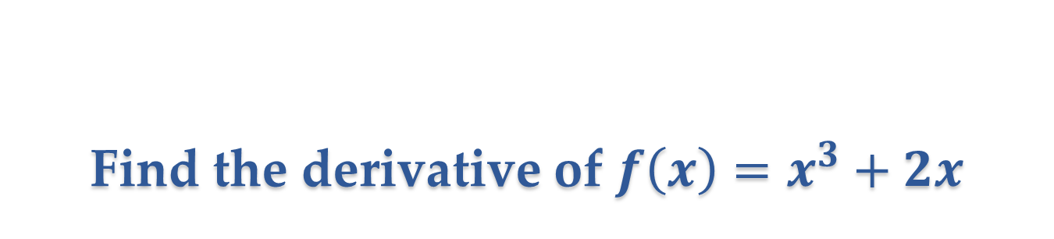
Find the derivative of $f\left(x\right)=x^{3}+2x$
$f^{′}\left(x\right)=\lim_{∆x→0}{\frac{f\left(x+∆x\right)−f(x)}{∆x}}= {\begin{aligned}\frac{{\left(x+∆x\right)}^{3}+2\left(x+x∆\right)−x^{3}−2x }{∆x}= \\ \frac{x^{3}+3x^{2}∆x+3x{\left(∆x\right)}^{2}+{\left(∆x\right)}^{3}+2x+2∆x−x^{3}−2x}{∆x}= \\ \lim_{∆x→0}{\frac{3x^{2}∆x+3x{\left(∆x\right)}^{2}+{\left(∆x\right)}^{3}+2∆x}{∆x}=} \\ 3x^{2}+3x∆x+{\left(∆x\right)}^{2}+2= \\ 3x^{2}+2\end{aligned}}$

Slide 31
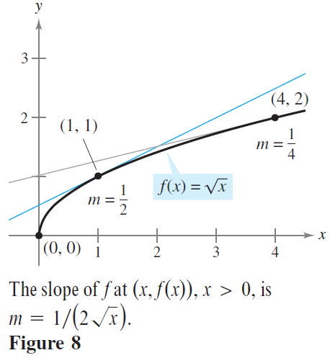
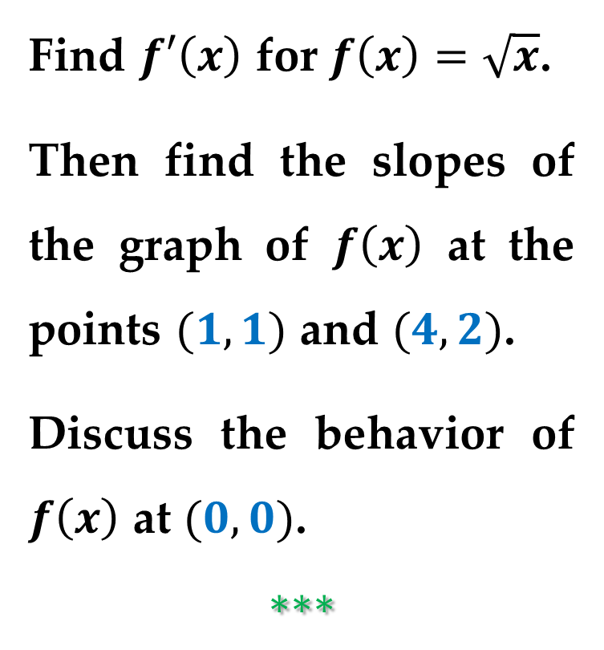
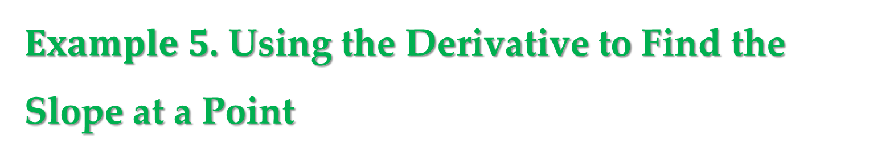
$Example 5$. Using the Derivative to Find the Slope at a Point
Find $f′\left(x\right)$ for $f\left(x\right)=\sqrt{x}$.
Then find the slopes of the graph of $f\left(x\right)$ at the points $(1,1)$ and $(4,2)$.
Discuss the behavior of $f\left(x\right)$ at $(0,0)$.
$$∗∗∗$$

Slide 32
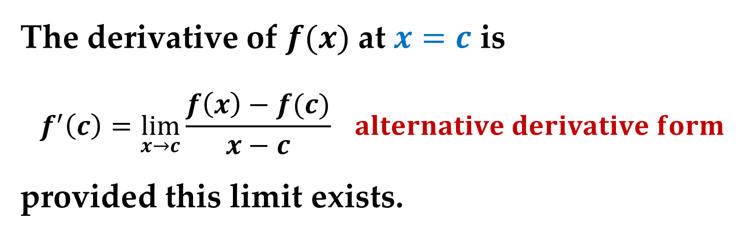
Differentiability and Continuity
The alternative limit form of the derivative shown below is useful in investigating the relationship between differentiability and continuity.
The derivative of $f(x)$ at $x=c$ is
$$f^{′}\left(c\right)=\lim_{x→c}{\frac{f\left(x\right)−f(c)}{x−c}} alternative derivative form$$
provided this limit exists.

Slide 33


$Figure 9$ illustrates this concept.
Note that the existence of the limit in this form requires that the one-sided limits
$$\lim_{x→c^{−}}{\frac{f\left(x\right)−f(c)}{x−c}}$$
$$\lim_{x→c^{+}}{\frac{f\left(x\right)−f(c)}{x−c}}$$
exist and are equal.

Slide 34

These one-sided limits are called the derivatives
$$\lim_{x→c^{−}}{\frac{f\left(x\right)−f(c)}{x−c}} from the left$$
$$\lim_{x→c^{+}}{\frac{f\left(x\right)−f(c)}{x−c}} from the right$$
respectively.

Slide 35

It follows that $f(x)$ is differentiable on the closed interval $[a,b]$ when it is differentiable on $(a,b)$ and when the derivative from the right at $a$ and the derivative from the left at $b$ both exist.

Slide 36


Remark
When a function is not continuous at $x=c,$ it is also not differentiable at $x=c$.
Although it is true that differentiability implies continuity (as will be seen further)$,$ the converse is not true:
it is possible for a function to be continuous at $x=c$ and not differentiable at $x=c$.

Slide 37


Example 6. A Graph with a Sharp Turn
The function $f\left(x\right)=\left|x−2\right|$ is continuous at $x=2$.
The one-sided limits$,$ however$,$
$$\lim_{x→2^{−}}{\frac{f\left(x\right)−f(2)}{x−2}}=\lim_{x→2^{−}}\frac{\left|x−2\right|−0}{x−2}=−1$$
$$\lim_{x→2^{+}}{\frac{f\left(x\right)−f(2)}{x−2}}=\lim_{x→2^{+}}\frac{\left|x−2\right|−0}{x−2}=1$$
are not equal.
So$,$ $f(x)$ is not differentiable at $x=2$ and the graph of $f(x)$ does not have a tangent line at the point $(2,0)$.

Slide 38


$Figure 10$ illustrates this behavior.

Slide 39



Example 7. A Graph with a Vertical Tangent Line
The function $f\left(x\right)=x^{1/3}$ is continuous at $x=0$ as shown in $Figure 11$.
The limit$,$ however$,$
$$\lim_{x→0}{\frac{f\left(x\right)−f(0)}{x−0}}=\lim_{x→0}{\frac{\sqrt[3]{x}−0}{x}}=\lim_{x→0}{\frac{1}{\sqrt[3]{x^{2}}}}=∞$$
is infinite.

Slide 40

So$,$ you can conclude that the tangent line is vertical at $x=0$ and $f(x)$ is not differentiable at $x=0$. ♠

Slide 41



Theorem. Differentiability and Continuity
If $f(x)$ is differentiable at $x=c$, then $f(x)$ is continuous at $x=c$.
Proof
You can prove that $f(x)$ is continuous at $x=c$ by showing that $f(x)$ approaches $f(c)$ as $x→c$.
To do this$,$ use the differentiability of $f(x)$ at $x=c$ and consider the limit process. $∗∗∗$

Slide 42


The relationship between continuity and differentiability is summarized below:
If a function is differentiable at $x=c,$ then it is continuous at $x=c$. So$,$ differentiability implies continuity.
It is possible for a function to be continuous at $x=c$ and not be differentiable at $x=c$.
So$,$ continuity does not imply differentiability.

Slide 43

From $Examples 6$ and $7,$ we can see that a function is not differentiable at a point at which its graph has a
sharp turn$;$
a vertical tangent line$.$

Slide 44
Thank you for attention

